Slide 1

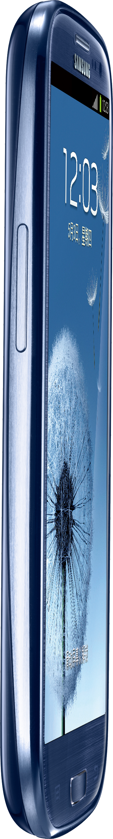



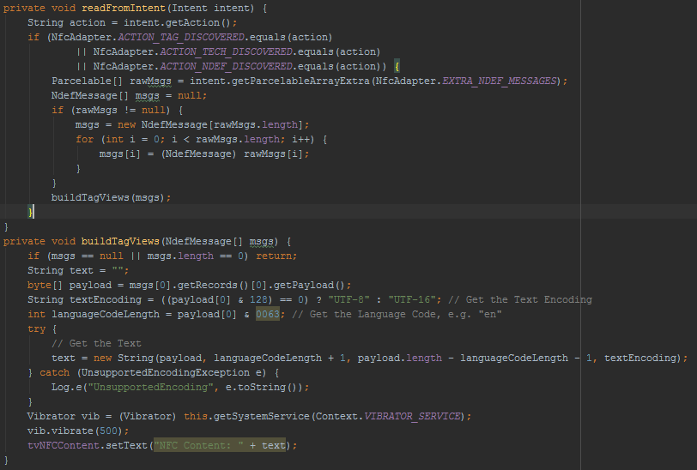
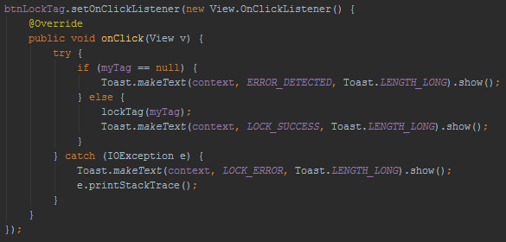
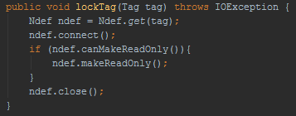
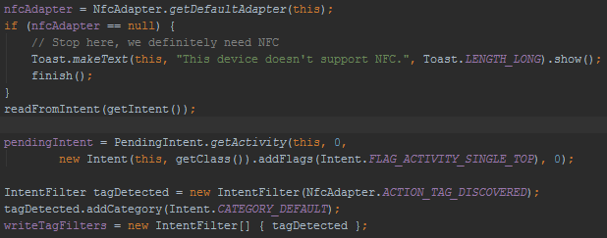





Abstract
Near Field Communication efficiently facilitates wireless, close-proximity transfer of relatively small amounts of data over a specifically defined radio frequency (13.56 MHz). Any Mobile device with integrated NFC hardware can actively generate a controlled electromagnetic field in order to stimulate an antenna, typically printed onto a thin, flat substrate referred to as a NFC “tag”. The energy transferred to the antenna is guided to an integrated circuit for processing Read/Write commands relevant to the tag’s memory module.
STATIC LOCK BYTES - Field Programmable Read-Only Locking Mechanism
MEMORY LOCATION - PAGE 02h (Hex)
DETAILS - Each bit represents an individual 16-bit page from 03h to 0Fh. Bits set to 1 permanently lock their corresponding pages as read-only.
COURSE INFORMATION
L7 | L6 | L5 | L4 | L CC | BL 15-10 | BL 9-4 | BL CC
L 15 | L 14 | L 13 | L 12 | L 11 | L 10 | L 9 | L 8
CNT 4514C: Wireless Networks and Mobile Computing
Professor Zornitza Genova Prodanoff
Spring Term 2017
NFC Tag Basic Information
Each 8-bit long byte is represented by a 2-digit hexadecimal value. From the tag’s beginning to end, every four sequential bytes forms a “page” of data. The first set of values (blue arrow) show the exact contents of an unmodified MIFARE Ultralight NFC Tag designed by the manufacturer NXP. The second set (green arrow) shows the exact values sent back to the tag after processing by the mobile app. In this case, the text “START” occupies the payload to be written.
CAPABILITY CONTAINER - One Time Programmable Bits
MEMORY LOCATION - PAGE 03h
DETAILS - Writability defined by Static Lock Bytes. Stores control data for managing NFC Forum defined data inside the tag.
CONTACT
LOCK0
Christopher Small
N00931863@ospreys.unf.edu
LOCK1
Locking Mechanism – Dynamic Lock Bytes
Highlighted in yellow, Lock Bytes 2-4 are called dynamic because their position(s) inside the tag can change, unlike Static Lock Bytes. Changing bits from 0 to 1 makes discrete blocks of memory Read-Only. A locked area may be composed of one or more pages. This feature is important for partitioning specific blocks of data while allowing freedom to define non-locked areas for writing. Along with Static Lock Bytes and the One Time Programmable Bytes, bits changed to 1 cannot be reset.
E1 | 10 | 12 | 00
Magic Number | NFC Type 2 Version Number | Data Area (144 Bytes) | R/W Access (No Security)
OTP1
DYNAMIC LOCK BYTES - Position Based Locking
MEMORY LOCATION - DYNAMIC
DETAILS - Used to lock discrete memory blocks after PAGE 15h.
OTP0
OTP2
Locking Mechanism – Static Lock Bytes
Highlighted in yellow are the two types of bytes that define which pages are “Read-Only”. Each bit of the Static Lock Bytes represent one or more pages. Changing these bits from 0 to 1 is irreversible.
OTP3
LOCK2
LOCK3
LOCK4
04 34 CB 73 2A 74 40 81 9F 48 00 00 E1 10 12 00 01 03 A0 0C 34 03 00 FE 00 00 00 00 00 00 00 00 00 00 00 00 00 00 00 00 00 00 00 00 00 00 00 00 00 00 00 00 00 00 00 00 00 00 00 00 00 00 00 00 00 00 00 00 00 00 00 00 00 00 00 00 00 00 00 00 00 00 00 00 00 00 00 00 00 00 00 00 00 00 00 00 00 00 00 00 00 00 00 00 00 00 00 00 00 00 00 00 00 00 00 00 00 00 00 00 00 00 00 00 00 00 00 00 00 00 00 00 00 00 00 00 00 00 00 00 00 00 00 00 00 00 00 00 00 00 00 00 00 00 00 00 00 00 00 00 00 00 00 BD 04 00 00 FF 00 05 -- -- FF FF FF FF 00 00 -- --
NEAR FIELD COMMUNICATION
04 34 CB 73 2A 74 40 81 9F 48 F8 FF E1 10 12 0F 01 03 A0 0C 34 03 3A 91 01 08 54 02 65 6E 53 54 41 52 54 54 0F 1C 61 6E 64 72 6F 69 64 2E 63 6F 6D 3A 70 6B 67 63 6E 74 34 35 31 34 63 2E 75 6E 66 73 79 6D 70 6F 73 69 75 6D 6E 66 63 71 75 69 7A FE 00 00 00 00 00 00 00 00 00 00 00 00 00 00 00 00 00 00 00 00 00 00 00 00 00 00 00 00 00 00 00 00 00 00 00 00 00 00 00 00 00 00 00 00 00 00 00 00 00 00 00 00 00 00 00 00 00 00 00 00 00 00 00 00 00 00 00 00 00 00 00 00 00 00 00 00 00 00 FF 01 00 BD 04 00 00 FF 00 05 -- -- FF FF FF FF 00 00 -- --
OTP0
OTP1
LOCK1
OTP2
OTP3
LOCK0
LOCK3
LOCK2
LOCK4
NDEF
NFC Data Exchange Format (NDEF) is a lightweight format used to encapsulate data of specific types. It takes the form of a single “message” containing one or more “records”. Each record has a type which defines the contained data. Mobile applications can use this metadata to determine how to process each record. For example, if a mobile device reads the contents of an NFC tag that contains a URL to a website, it will receive the entire contents of the tag’s data in the form of an NDEF message. The device requesting the data can then parse through the record’s data and process it according to its defined type. The device would recognize the data as a URL and attempt to open a web browser. NDEF supports URL/URI, MIME Media, and Text data types. Other special types are available to define empty, unknown, or external (user defined) data types.
Specifically regarding the functions used to write data to NFC tags, the code boxes around the locked tag image show how a button tap initializes tag detection, NFC adapter initialization, and intent creation and filtering. The lockTag method shows how simple it is for developers to include tag-locking functionality in an application. However, this method simply makes the entire contents of the tag Read-Only. More complex is the code needed to lock specifically defined blocks of memory. In addition to locking, there have been efforts devoted to integrating encryption and device/application authentication using current NFC technology, though no NFC tags, protocols, or integrated circuits have been widely developed with native support.
Tag Details
NFC Tags contain an antenna coil connected to a small integrated circuit. Tag characteristics include memory capacity, lockability, pre-NDEF formatted, and cost. Applying adhesive is a commonly requested feature. Presented here are MIFARE Ultralight C tags from NXP.
LOCKED
Summary
Developing and implementing NFC technology requires great investments in time and planning, but if done effectively, the user experience can feel magical. Thanks to standardizations in data formatting and electro-mechanics developed by ISO/IEC, NXP, and the various companies that make up the NFC Forum, this technology will surely maintain relevancy despite its relatively narrow use case domain.
The code shown here highlights the key functions needed to read and write data to and from NFC tags. Applications installed on mobile devices, in this case, Android powered devices, can be executed once an intent is established if the tag contains an AAR (Android Application Record) as the first record in the NDEF message. This code from the NFC Read/Write App used to program all presented NFC tags shows how bytes in the record are parsed and assembled to form a string of text and then displayed on the device’s screen along with a brief vibration.
Choosing Android as a Development Platform
Though NFC technology and protocols were designed to be software agnostic, Google’s Android Operating System provides more freedom for software developers to take advantage of NFC hardware. The mobile application presented supports APIs version 19 (KitKat) and older. It was developed and tested using Android Studio, and tested on a Samsung Galaxy SIII. Code files were written primarily in Java and XML.
REFERENCES
M. Roland and J. Langer, "Digital Signature Records for the NFC Data Exchange Format," 2010 Second International Workshop on Near Field Communication, Monaco, 2010, pp. 71-76. doi: 10.1109/NFC.2010.10
B. Jepson, D. Coleman, and T. Igoe, 4. Introducing NDEF [Book]. Safari, 2017. [Online]. Available: https://www.safaribooksonline.com/library/view/beginning-nfc/9781449324094/ch04.html. Accessed: Feb. 2, 2017.
NFC, Forum. "NFC Forum Technical Specifications Improve RF Communication and NFC Tag Interoperability with NFC Devices." Business Wire (English) Dec. 0010: Regional Business News. Web. 1 Feb. 2017.
electrical 4 u, "Air core transformer," 2011. [Online]. Available: http://www.electrical4u.com/air-core-transformer/. Accessed: Feb. 1, 2017.
NFC Forum, 1st ed. NFC Data Exchange Format (NDEF) Technical Specification, 1st ed. Wakefield, MA: NFC Forum, 2006. Web. 27 Mar. 2017.

